Slide 1
Copyright © 2014 Pearson Education, Inc.

Slide 2
Chapter 8
Online Retail and Services
Copyright © 2014 Pearson Education, Inc.

Slide 3
Blue Nile Sparkles for Your Cleopatra
Why is selling (or buying) diamonds over the Internet difficult?
How has Blue Nile built its supply chain to keep costs low?
How has Blue Nile reduced consumer anxiety over online diamond purchases?
What are some vulnerabilities facing Blue Nile?
Would you buy a $5,000 engagement ring at Blue Nile?
Copyright © 2014 Pearson Education, Inc.
Slide 8-<number>

Slide 4
The Retail Sector
Most important theme in online retailing is effort to integrate online and offline operations
U.S. retail market accounts for $11.1 trillion (71%) of total GDP
Copyright © 2014 Pearson Education, Inc.
Slide 8-<number>

Slide 5
The Retail Industry
Seven segments (clothing, durable goods, etc.)
  For each, uses of Internet may differ
    Information vs. direct purchasing
Mail order/telephone order (MOTO) sector most similar to online retail sector
  Sophisticated order entry, delivery, inventory control systems
Copyright © 2014 Pearson Education, Inc.
Slide 8-<number>

Slide 6
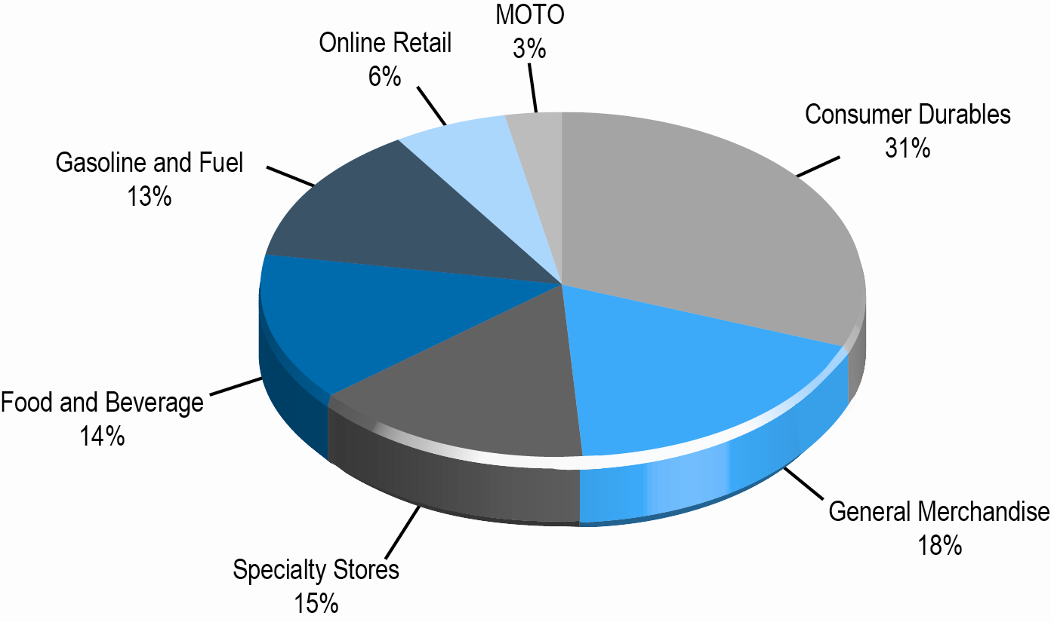
Composition of the U.S. Retail Industry
Figure 8.1, Page 314
SOURCE: Based on data from U.S. Census Bureau, 2012.
Copyright © 2014 Pearson Education, Inc.
Slide 8-<number>

Slide 7
E-commerce Retail: The Vision
  Reduced search and transaction costs; customers able to find lowest prices
  Lowered market entry costs, lower operating costs, higher efficiency
  Traditional physical store merchants forced out of business
  Some industries would be disintermediated
  Few of these assumptions proved correct—structure of retail marketplace has not been revolutionized
  Internet has created new venues for multi-channel firms and supported a few pure-play merchants
Copyright © 2014 Pearson Education, Inc.
Slide 8-<number>

Slide 8
The Online Retail Sector Today
Smallest segment of retail industry (5%–6%)
Growing at faster rate than offline segments
Revenues have resumed growth
Around 72% of Internet users bought online in 2012
Primary beneficiaries:
  Established offline retailers with online presence (e.g.: Staples)
  First mover dot-com companies (e.g.: Amazon)
Copyright © 2014 Pearson Education, Inc.
Slide 8-<number>

Slide 9
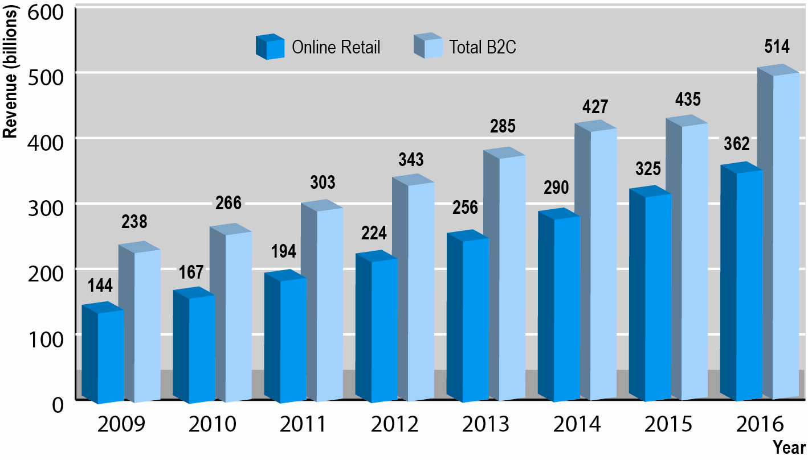
Online Retail and B2C E-commerce Is Alive and Well
Figure 8.2, p. 316
SOURCES: Based on data from eMarketer, Inc., 2012a; authors’ estimates.
Copyright © 2014 Pearson Education, Inc.
Slide 8-<number>

Slide 10
Multi-channel Integration
Integrating Web operations with traditional physical store operations
  Provide integrated shopping experience
  Leverage value of physical store
Types of integration
  Online order, in-store pickup
  Web promotions to drive customers to stores
  Gift cards usable in any channel
Increasing importance of mobile devices, social commerce, and tablets
Copyright © 2014 Pearson Education, Inc.
Slide 8-<number>

Slide 11
E-tailing Business Models
Virtual merchant
  Amazon
Bricks and clicks
  Walmart, J.C. Penney, Sears
Catalog merchant
  Lands’ End, L.L. Bean, Victoria’s Secret
Manufacturer-direct
  Dell
Copyright © 2014 Pearson Education, Inc.
Slide 8-<number>

Slide 12
Common Themes in Online Retailing
Online retail fastest growing channel on revenue basis
Profits for startup ventures have been difficult to achieve
Disintermediation has not occurred
Established merchants need to create integrated shopping experience to succeed online
Growth of online specialty merchants, e.g. Blue Nile
Extraordinary growth of social, local, and mobile e-commerce
Copyright © 2014 Pearson Education, Inc.
Slide 8-<number>

Slide 13
Using the Web to Shop Till You Drop
What do comparison sites offer consumers?
Why are comparison shopping sites more successful with hard goods than soft goods?
What is the strategy of Shopping.com?
How can shopping bots compare luxury goods?
How does adding content to comparison sites help consumers?
Copyright © 2014 Pearson Education, Inc.
Slide 8-<number>

Slide 14
Online Services
Service sector:
  Largest and most rapidly expanding part of economies of advanced industrial nations
  Concerned with performing tasks in and around households, business firms, and institutions
    Includes doctors, lawyers, accountants, business consultants, etc.
  Employs four out of five U.S. workers
  75% of economic activity
Copyright © 2014 Pearson Education, Inc.
Slide 8-<number>

Slide 15
Online Financial Services
Example of e-commerce success story, but success is somewhat different from what had been predicted
Brokerage industry transformed
62% of customers prefer online banking
Effects less powerful in insurance, real estate
Multi-channel, established financial services firms continue to show growth
Copyright © 2014 Pearson Education, Inc.
Slide 8-<number>

Slide 16
Online Financial Consumer Behavior
Consumers attracted to online financial sites because of desire to save time and access information rather than save money
Most online consumers use financial services firms for mundane financial management
  Check balances
  Pay bills
Number of people using mobile devices for financial services is surging
Copyright © 2014 Pearson Education, Inc.
Slide 8-<number>

Slide 17
Online Banking and Brokerage
Online banking pioneered by NetBank and Wingspan; neither still in existence
Established brand-name national banks have taken substantial lead in market share
107 million people use online banking; expected to rise to 116 million by 2014
Early innovators in online brokerage (E*Trade) have been challenged by established brokerages (Fidelity, Schwab)
Copyright © 2014 Pearson Education, Inc.
Slide 8-<number>

Slide 18
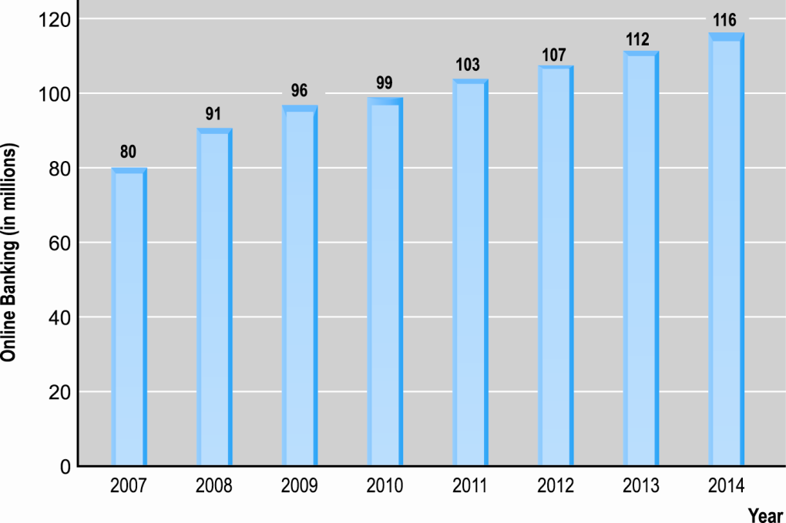
The Growth of Online Banking
SOURCE: Based on data from comScore, 2010a, eMarketer, Inc., 2010; authors’ estimates.
Figure 8.3, Page 328
Copyright © 2014 Pearson Education, Inc.
Slide 8-<number>

Slide 19
Multi-channel vs.
Pure Online Financial Service Firms
Online consumers prefer multi-channel firms with physical presence
Multi-channel firms
  Growing faster than pure online firms
  Lower online customer acquisition costs
Pure online firms
  Cannot provide all services that require face-to-face interaction
Copyright © 2014 Pearson Education, Inc.
Slide 8-<number>

Slide 20
Financial Portals and
Account Aggregators
Financial portals
  Comparison shopping services, independent financial advice, financial planning
  Revenues from advertising, referrals, subscriptions
  e.g.: Yahoo! Finance, Quicken.com, MSN Money
Account aggregation
  Pulls together all of a customer’s financial data at a personalized Web site
  e.g.: Yodlee: provides account aggregation technology
  Privacy concerns; control of personal data, security, etc.
Copyright © 2014 Pearson Education, Inc.
Slide 8-<number>

Slide 21
Online Mortgage and
Lending Services
Early entrants hoped to simplify and speed up mortgage value chain
Most early-entry, pure-online firms failed
Today, slowly growing; dominated by established online banks, financial services firms and traditional mortgage vendors
Copyright © 2014 Pearson Education, Inc.
Slide 8-<number>

Slide 22
Online Insurance Services
Online term life insurance
  One of few online insurance with lowered search costs, increased price comparison, lower prices
  Commodity
Most insurance not purchased online
Online industry geared more toward
  Product information, search
  Price discovery
  Online quotes
  Influencing the offline purchasing decision
Copyright © 2014 Pearson Education, Inc.
Slide 8-<number>

Slide 23
Online Real Estate Services
Early vision: Disintermediation of a complex industry
However, major impact is influencing of purchases offline
  Impossible to complete property transaction online
  Main services are online property listings, loan calculators, research and reference material, with mobile apps increasing
Despite revolution in available information, there has not been a revolution in the industry value chain
Copyright © 2014 Pearson Education, Inc.
Slide 8-<number>

Slide 24
Online Travel Services
One of the most successful B2C e-commerce segments
Online travel bookings declined slightly due to recession but expected to grow to $150 billion in 2016
For consumers: More convenient than traditional travel agents
For suppliers: A singular, focused customer pool that can be efficiently reached through onsite advertising
Copyright © 2014 Pearson Education, Inc.
Slide 8-<number>

Slide 25
Online Travel Services (cont.)
Travel an ideal service/product for Internet
  Information-intensive product
  Electronic product—travel arrangements can be accomplished for the most part online
  Does not require inventory
  Does not require physical offices with multiple employees
  Suppliers are always looking for customers to fill excess capacity
  Does not require an expensive multi-channel presence
Copyright © 2014 Pearson Education, Inc.
Slide 8-<number>

Slide 26
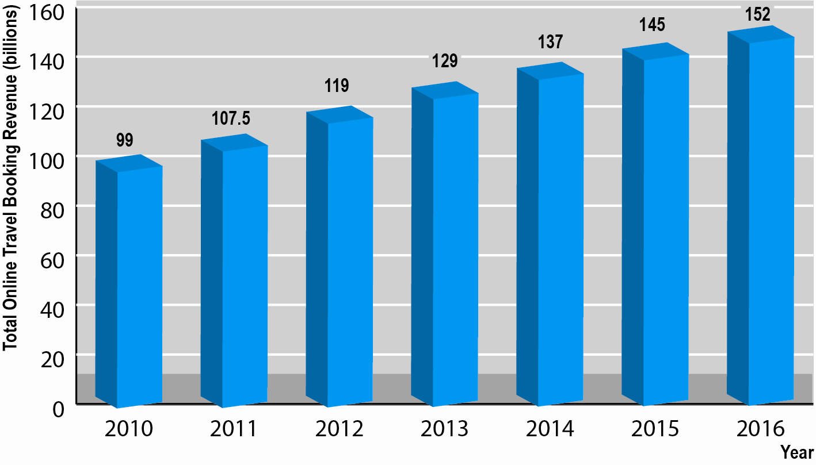
Online Travel Services Revenues
Figure 8.4, Page 332
SOURCE: Based on data from eMarketer, 2012.
Copyright © 2014 Pearson Education, Inc.
Slide 8-<number>

Slide 27
The Online Travel Market
Four major sectors:
  Airline tickets
  Hotel reservations
  Car rentals
  Cruises/tours
57% purchase airline tickets from airline’s Web site, 22% from travel booking Web site (e.g.: Expedia)
Copyright © 2014 Pearson Education, Inc.
Slide 8-<number>

Slide 28
Online Travel Industry Dynamics
Intense competition among online providers
Price competition difficult
Industry consolidation
Industry impacted by meta-search engines
  Commoditize online travel
Mobile applications are also transforming industry
Social media content, reviews have an increasing influence on travel purchases
Copyright © 2014 Pearson Education, Inc.
Slide 8-<number>

Slide 29
Phony Reviews
Should there be repercussions to individuals and/or businesses for posting false reviews of products or services?
Can phony reviews be recognized and moderated?
Do you rely more on some types of reviews or comments on Web sites and blogs over others?
Copyright © 2014 Pearson Education, Inc.
Slide 8-<number>

Slide 30
Online Career Services
Top sites generate over $1 billion annually
Two main players: CareerBuilder, Monster
Traditional recruitment tools
  Classified, print ads, career expos, on-campus recruitment, staffing firms, internal referral programs
Online recruiting
  More efficient, cost-effective, reduces total time-to-hire
  Enables job hunters to more easily distribute resumes while conducting job searches
  Ideally suited for Web due to information-intense nature of process
Copyright © 2014 Pearson Education, Inc.
Slide 8-<number>

Slide 31
It’s Just Information:
The Ideal Web Business?
Recruitment ideally suited for the Web
  Information-intense process
  Initial match-up doesn’t require much personalization
Saves time and money for both job hunters and employers
One of most important functions
  Ability to establish market prices and terms (online national marketplace)
Copyright © 2014 Pearson Education, Inc.
Slide 8-<number>

Slide 32
Copyright © 2014 Pearson Education, Inc.
Slide 8-<number>

